Slide 1
Data Storytelling
DC Traffic Violations: 2018-2020

Slide 2
Questions
What percentage of DC traffic tickets are automatic?
Count? Revenue?
Are there any trends overtime?
Do some wards see more automatic traffic violations than others?

Slide 3
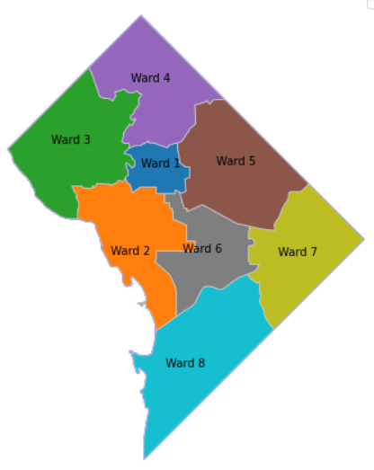
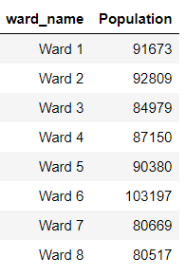
Washington DC’s 8 Wards
Ward Map
Ward Populations 2021

Slide 4
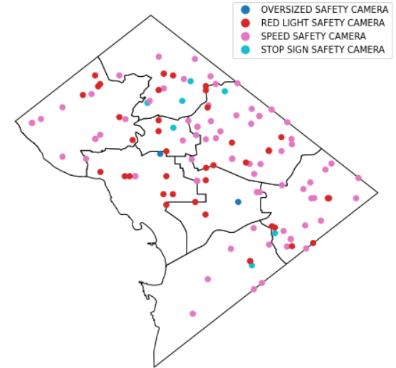
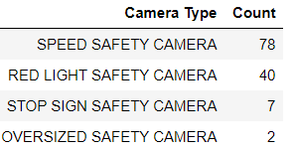
Automated Traffic Cameras
Camera Locations
Camera Type Counts

Slide 5
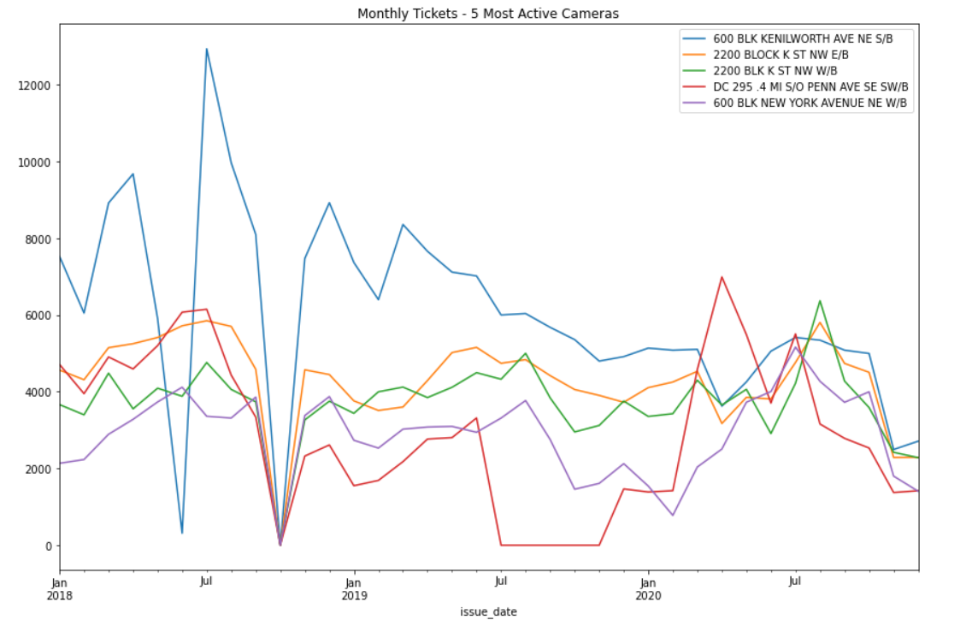
*Missing October 2018 Data

Slide 6
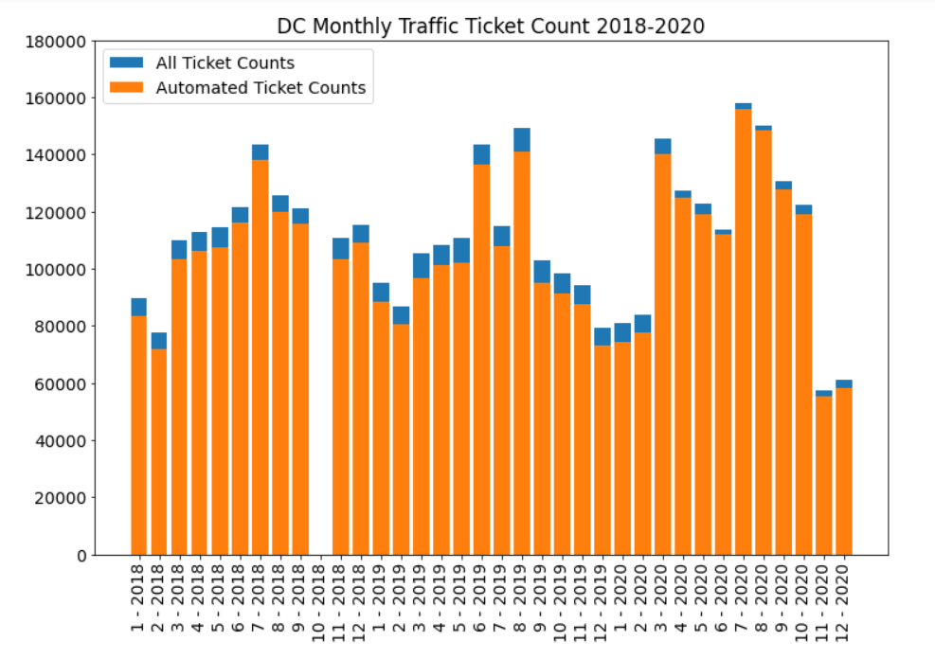
Reduction of non-automatic tickets share with start of COVID-19 Pandemic (post March 2020)
Lowest ticket # overall – due to less traffic? Or less enforcement?
*Missing October 2018 Data

Slide 7
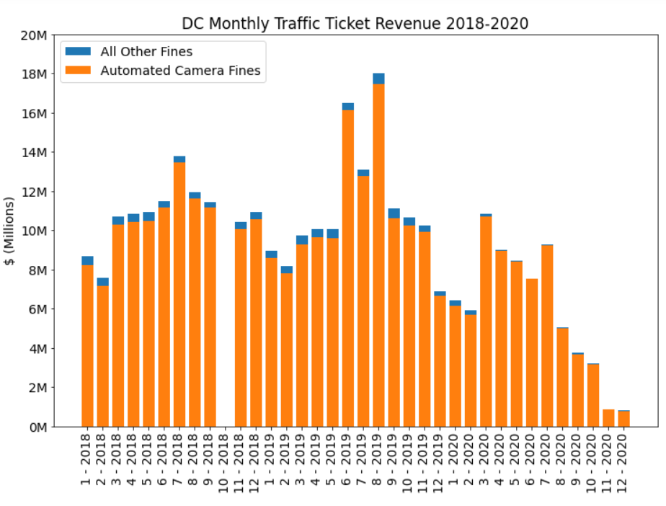
Much lower revenue during the pandemic– perhaps due to policy change?
*Missing October 2018 Data

Slide 8
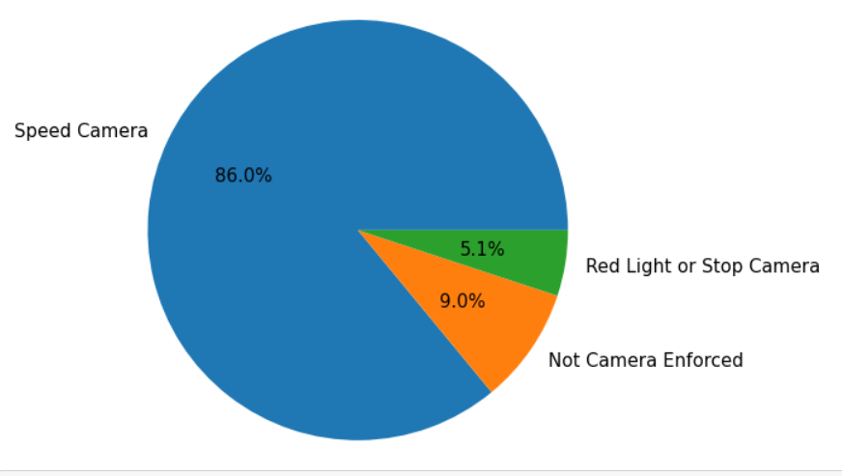
DC Moving Violations 2018-2020
Automated tickets make up the majority of traffic tickets in DC
*Missing October 2018 Data

Slide 9
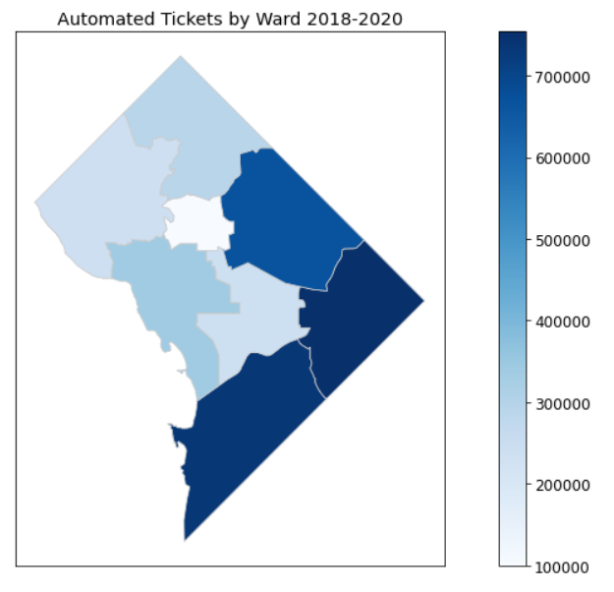
Wards 7, 8 & 5 see the most automated tickets
*Missing October 2018 Data

